Slide 1
Castle scratch back housing Issue
FACA report
CNT
10/04/2025

Slide 2
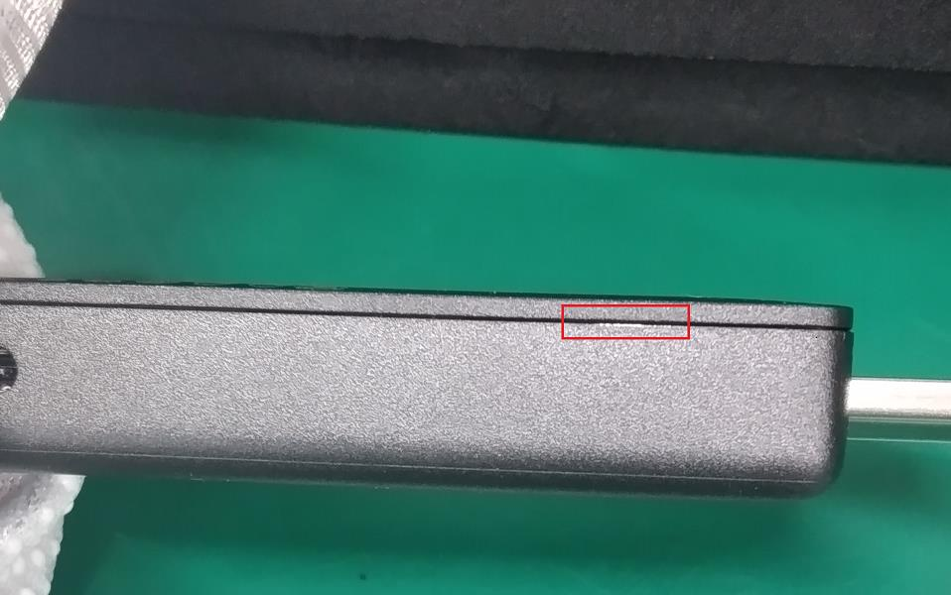
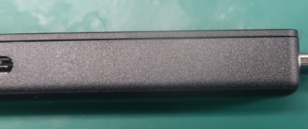
I
Issue Description
What: Castle 52-100667 DVT scratch housing.
When: 03/10/2025.
Where: B08-3F Castle line.
Who: Customer DQM.
Why: DQM went to production line to audit at OBA 3 found that housing was scratch.
How many: F/R=1F/281T=0.35%
NG
OK

Slide 3



II
Failure analysis
Device Test flow chart
Device Test
FTS
Run-in
Run-out
NPT
(Sampling)
FPS
Laser security code
Review Testing flow chart, several station may have risk to make happened this symptoms:
FTS station
FPS station
Laser security code station

Slide 4
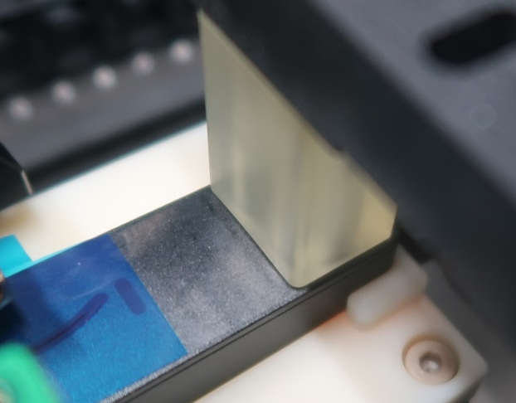
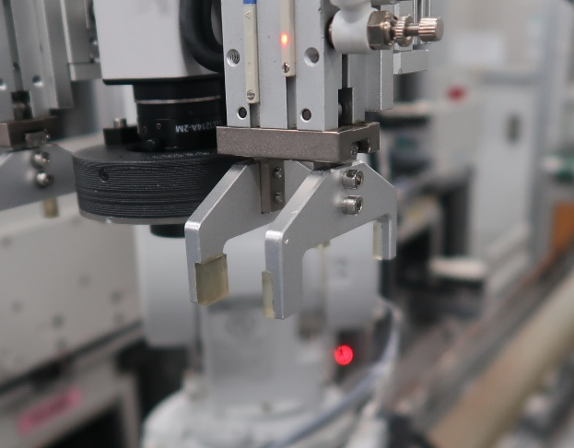
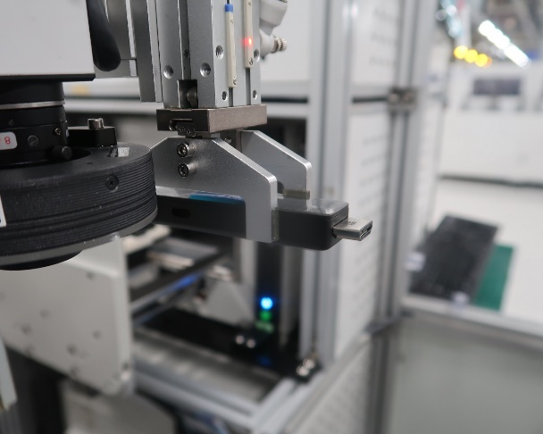
II
Failure analysis
1. FTS station
FTS clamp position is on the top face of device, not touch or impact to scratch position (Pic. 1).
The claws of the robot are covered by a silicon pad, cannot create scratches on the housing (Pic. 2 & Pic. 3).
No risk from this station.
Pic.1
Pic.2
Pic.3
FTS clamp position is on the top of device, not touch or impact to scratch position.
Scratch position
The claws of robot was be cover by silicon pad

Slide 5
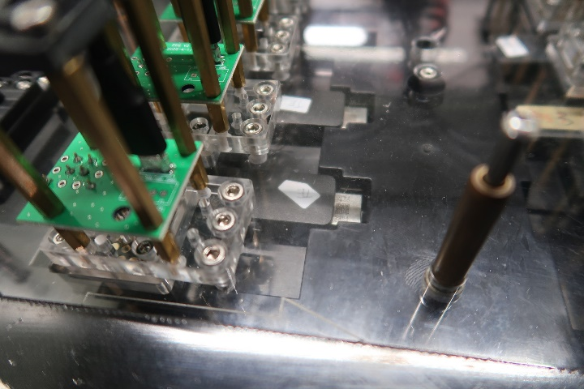
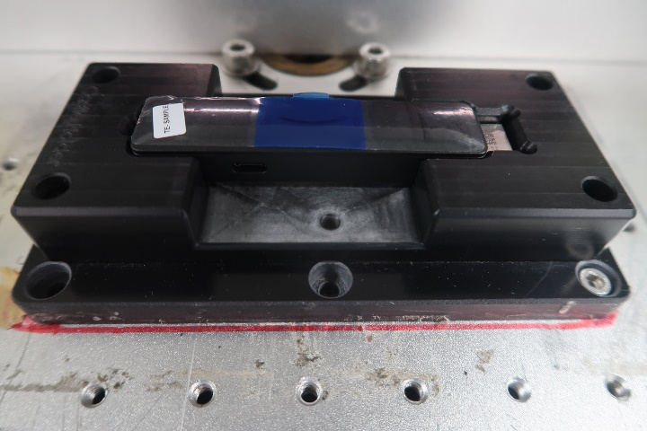
II
Failure analysis
2. FPS station
There is no clamp or tray impact to scratch position
No risk from this station
3. Laser security code station
Holder not touch to scratch position.
There is no clamp or robot claws in this station
No risk from this station
There is no clamp or tray impact to scratch position
Holder not touch to scratch position

Slide 6

III
Conclusion
Check all Test station → Found no abnormalities
Suggestion to monitoring this issue on PVT phase
IV
Action
SI keep to monitoring this issue on PVT phase
Owner: SI A Thuy Due date: PVT Status: Monitor

Slide 7
Thank you

